Slide 1

Apple Production in Ontario
Rahil Deepakkumar Pancholi
0797544

Slide 2
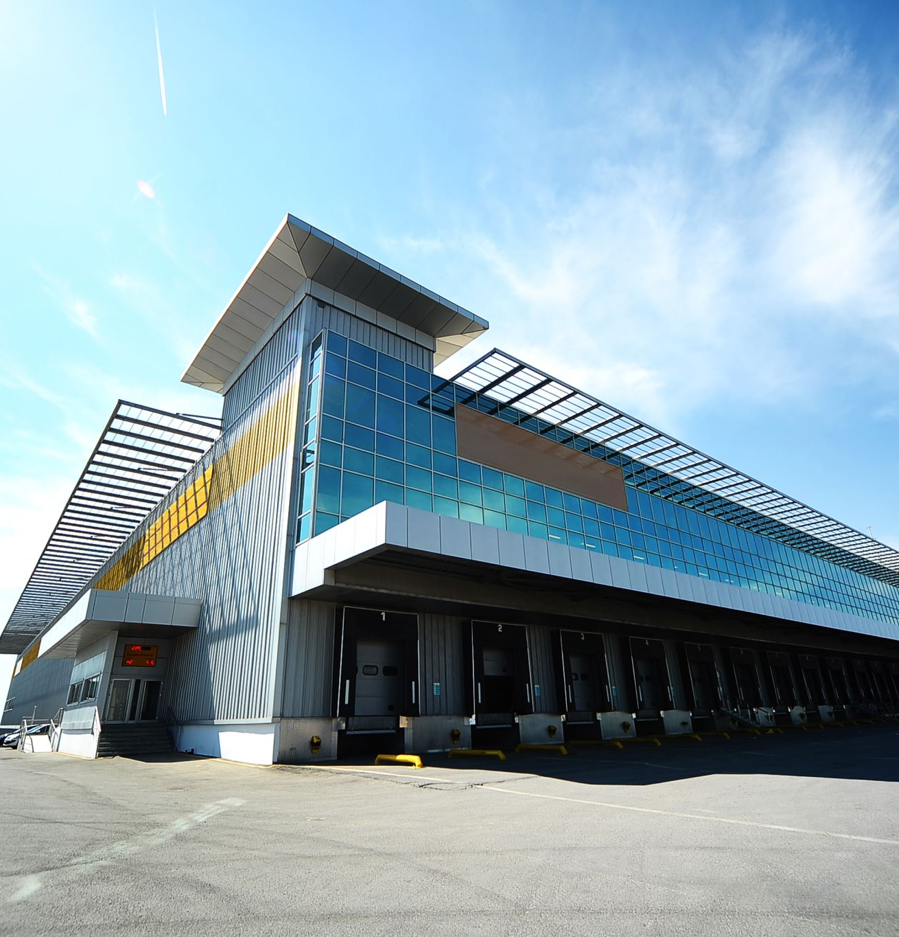
Problem Statement:
There is this private organization who is based in Ontario who sell Vegetables, Grocery, and other daily routine products in their supermarket. They want to Place an order of Apples in large amount from different places in Ontario, For, this project they have a team who are seeing this, and their Motto for this project is “An Apple A Day Keep the Doctor Away”.
The counties of Ontario are well-known for producing high-quality apples. To address the increased demand for fresh and locally produced products, purchase apples from counties and districts who produce apples.
We have found many apple farmers in Ontario that fulfil our quality and environmental requirements. Our strategy is to develop long-term connections with these producers in order to maintain a consistent supply of apples throughout the year.
We acknowledge that shipping apples from Ontario to our distribution facilities may present obstacles, but we think that the benefits of providing locally produced apples to our clients exceed the logistical concerns.
Overall, we are looking forward to working with Ontario apple producers and feel that this collaboration will benefit both our organization and the local farming community.

Slide 3
Business Questions:
How have apple prices fluctuated over the years, and what factors have influenced these changes?
Which counties and districts in Ontario are the largest producers of apples?
How has the distribution of apple production shifted over time?
What are the key distribution channels for Ontario-grown apples, and how do they differ from imported apples?
What promotional strategies are being used by competitors in the Ontario apple market, and how do they compare to those of Ontario growers?

Slide 4
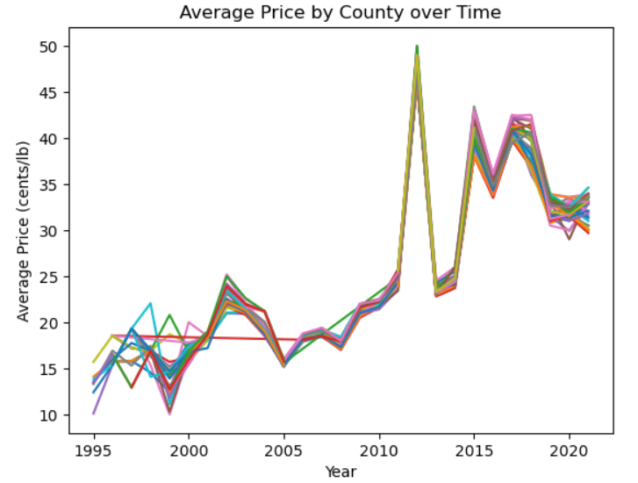
How have apple prices fluctuated over the years, and what factors have influenced these changes?
Over the span of 25 years, Price in Ontario apple has been steadily increasing, starting from around 10 cent per lb., now it is between 30-35 cents per lb.
In the year of 2012 it increased significantly, per pound due to a lower supply caused by weather-related issues.
From 1995 – 2010, it was between 10 cents to 25 cents.
But After that the baseline of the price is 25 cents.

Slide 5
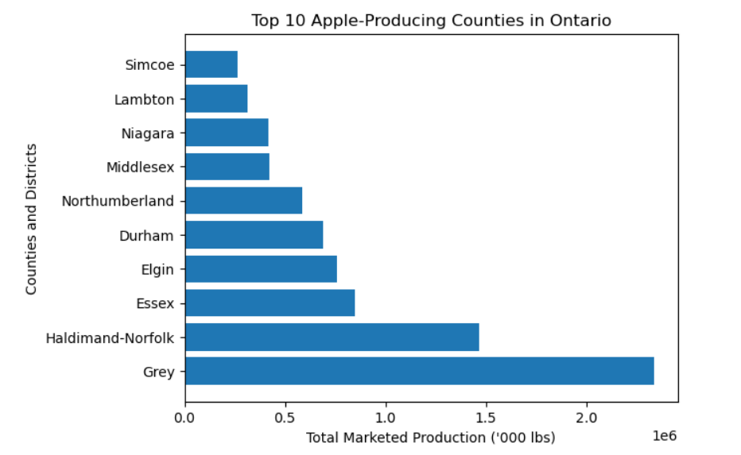
Which counties and districts in Ontario are the largest producers of apples?
This are some of the counties who are largest producer of apples in Ontario.
We can say that Grey county is producing by far more apples than any other counties.
Grey County has a milder environment than some of Ontario's other apple-producing regions, making it excellent for cultivating apple types that require a longer growing season.
Though, Haldimand-Norfolk and Essex are also on second and third apple producer counties in Ontario.

Slide 6
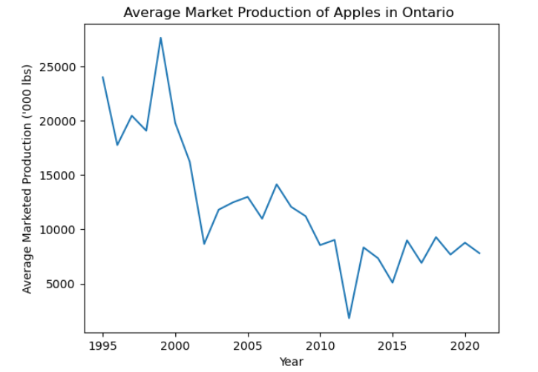
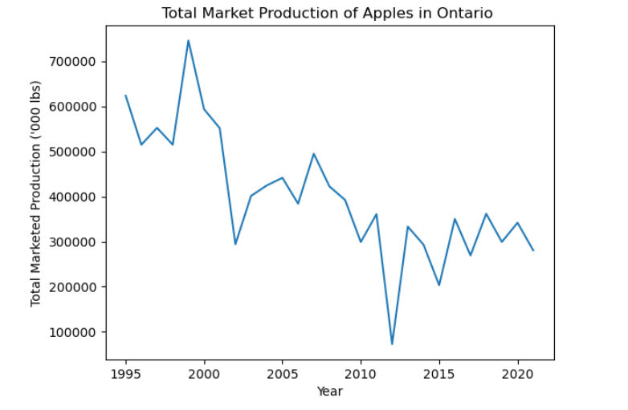
How has the Production of apple production shifted over time?
Apple production in Ontario has been falling in recent years owing to a variety of issues including competition from imported apples, ageing orchards, and regional producers' problems.
We can see from the line chart, that It is declining from the time to time.
In year 2021 the production is half of what was in year 1995.
As we saw the price chart, there also the price went up in year 2012, so here the production plummeted in the year 2012 we can see that due to weather-related issues.

Slide 7
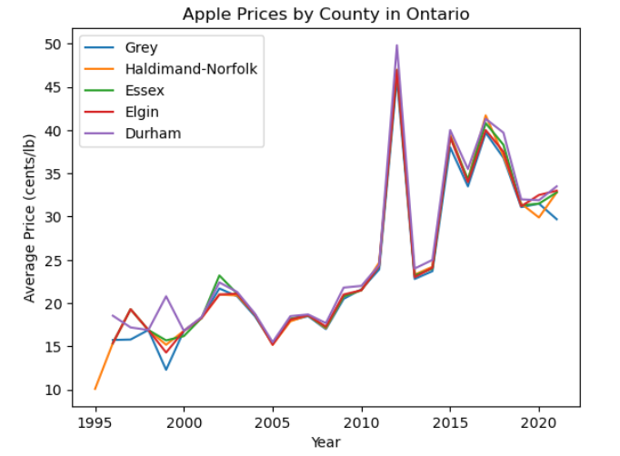
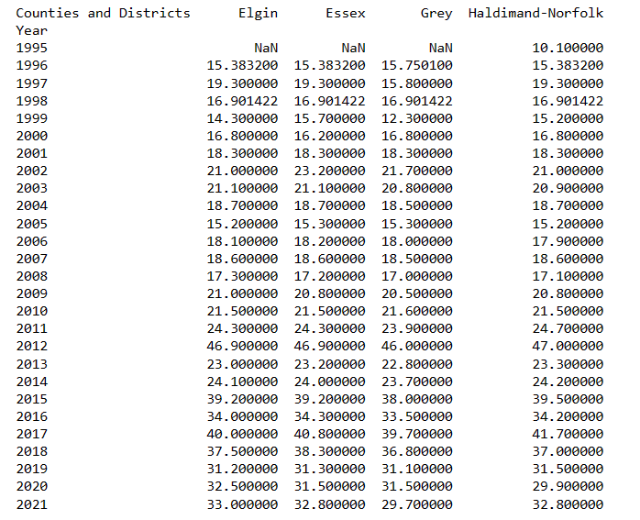
Apple prices by first 5 counties
Here, We can see the price of apple per lb. in the given chart and table.
We can say that Grey county is one of the place where price is lowest, as they produce more apple than other counties.
If we take data for year 2021, Grey county come first with 29.700 cent per lb. then Essex and Haldimand-Norfolk are come second with 32.80 cent per lb. while Elgin county’s apple sales at 33 cent per lb.

Slide 8
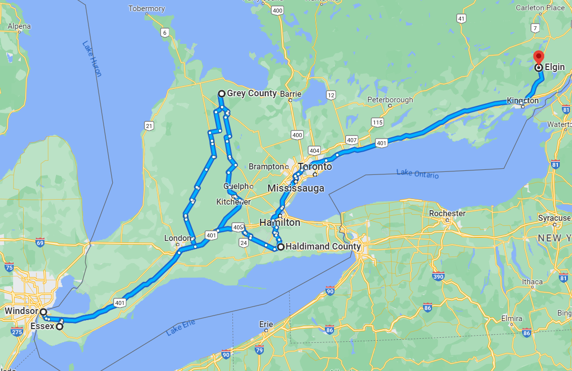
From where to Buy apples.
As the organization is based in Windsor, There are two nearest and profitable options that we can buy apple from.
First is Essex county, who sales at 32.80 cent per lb. and it is near to Windsor. Half hour of drive with around 30km.
Second option is Grey county, who sales at 29.70 cent per lb. and it is around 400 km which takes approx. 5-7 hour of drive.
Other two counties are expensive compared to this two and far away in distance.

Slide 9
What are the key distribution channels for Ontario-grown apples, and how do they differ from imported apples?
Grocery stores: Apples grown in Ontario are frequently available in supermarkets all around the province. A variety of apples grown in Ontario are frequently available in major supermarket chains like Loblaws, Sobeys, and Metro, where they are frequently prominently displayed in the produce area.
Farmers' markets: Throughout Ontario, there are numerous farmers' markets that sell apples that were grown nearby. These markets may be fantastic places for people to meet farmers in person and buy locally grown, fresh goods.Direct-to-consumer sales are made available by a few apple orchards in Ontario, either through their own brick-and-mortar storefronts or online. This enables customers to get fresh apples straight from the producer.
Imported apples can be purchased through the same channels as Ontario-grown apples, as well as specialty food stores, importers, and wholesalers. Furthermore, imported apples can be purchased all year, but Ontario-grown apples are often only accessible during the harvest season.

Slide 10
What promotional strategies are being used by competitors in the Ontario apple market, and how do they compare to those of Ontario growers?
Product quality: Ontario apple growers may emphasise the quality of their produce because it's possible that consumers may consider locally grown apples to be fresher and of greater quality than apples from other countries.
Eco-friendliness: Apple growers in Ontario may advertise their products as eco-friendly since they may employ environmentally beneficial farming methods.
Promotions in-store: To draw people into their stores, rivals may provide discounts, coupons, or exclusive offers on their own products.
Social media: Competitors may use sites like Instagram, Facebook, or Twitter to interact with consumers, advertise their goods, and raise their brands' visibility.

Slide 11
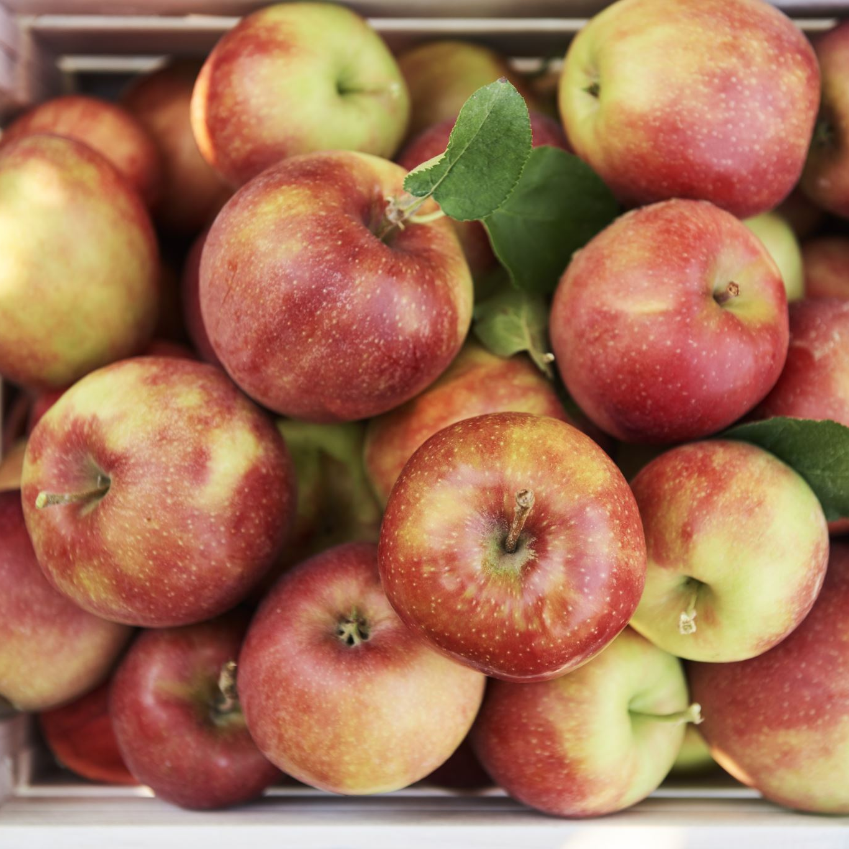
Recommendations
Choose high-quality apples:
Make sure the apples you're selling are of good quality, devoid of defects, and have a nice color and texture. This will assist you in attracting more consumers who are looking for fresh and delicious apples.
Proper storage:
Apples should be stored in a cool, dry place with good ventilation to avoid spoilage. Inspect apples regularly for signs of damage or spoilage and remove from display.
Display and Presentation:
Present the apples in an attractive way. B. Place it on a basket or tiered shelf to make it more attractive to customers. Rotate your apples regularly so that the older ones go on sale first.
Pricing strategy:
Set your prices competitively and make sure they reflect current market prices. Offer promotions and discounts to attract more customers and encourage them to buy more apples.

Slide 12

Thank You

